Slide 1
ISO 27001 Awareness Presentation
A.D.Jaliya – IT19991290

Slide 2
Content
What is information?
What is information security?
What is risk?
Introduction to the ISO standards
Managing information security
Your security responsibilities

Slide 3
Information is an asset which,like other important business assets, has value to an organisation and consequently needs to be suitably protected

Slide 4
Information exists in many forms:
Printed or written on paper
Stored electronically
Transmitted by post or electronic means
Visual e.g. videos, diagrams
Published on the Web
Verbal/aural e.g. conversations, phone calls
Intangible e.g. knowledge, experience, expertise, ideas

Slide 5
Information can be
Created
Owned (it is an asset)
Stored
Processed
Transmitted/communicated
Used (for proper or improper purposes)
Modified or corrupted
Shared or disclosed (whether appropriately or not)
Destroyed or lost
Stolen
Controlled, secured and protected throughout its existence

Slide 6
What is information security?
Information security refers to the methods and methodologies used to secure confidential, private, and sensitive information or data in print, electronic, or any other form against unauthorized access, use, misuse, disclosure, destruction, modification, or disruption.

Slide 7
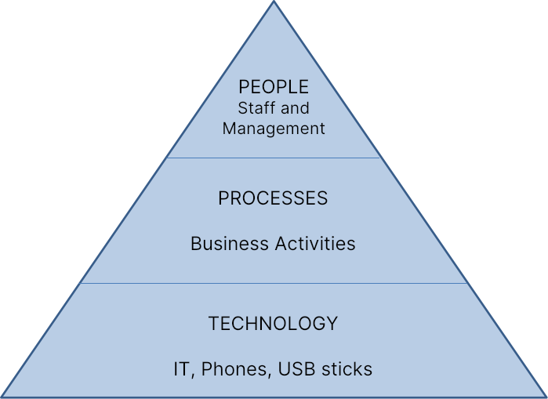
Security Elements

Slide 8
People
People are our greatest risks (social engineers, unethical rivals, hackers, fraudsters, sloppy workers, bugs, weaknesses, and so on), but our greatest asset is our people (e.g. security-aware employees who spot trouble early)

Slide 9
Processes
Work practices, often known as workflows, are the procedures or actions required to achieve company objectives. Procedures define how processes work. Information is used in almost every business operation and/or relies on it, making it a valuable business asset. Information security policies and procedures specify how we safeguard data in a consistent and reasonable manner.

Slide 10
Information technologies
Cabling, data/voice networks and equipment
Telecommunications services (PABX, VoIP, ISDN, videoconferencing)
Phones, cellphones, PDAs
Computer servers, desktops and associated data storage devices (disks, tapes)
Operating system and application software
Paperwork, files
Pens, ink

Slide 11
Security technologies
Locks, barriers, card-access systems, CCTV

Slide 12
Why information security is valuable?
Information is safeguarded against a variety of risks.
Ensures the continuation of the business
Reduces financial losses and other negative consequences.
Optimizes investment returns
Provides chances to conduct business in a secure manner. Privacy and compliance are protected.

Slide 13
The preservation of information security is defined as:
Confidentiality
Integrity
Availability

Slide 14
Causes of Security Incidents
Business disruption due to IT outages
Costs and financial losses
Intellectual property is being devalued.
Laws and regulations are broken, resulting in prosecutions, fines, and penalties.
Damage to one's reputation and brand, resulting in a loss of client, market, business partner, or owner confidence, as well as lost business. Fear, uncertainty, and skepticism

Slide 15
What is Risk?
The probability that a danger exploits a weakness in an information asset, resulting in a negative impact on the organization, is referred to as risk.

Slide 16
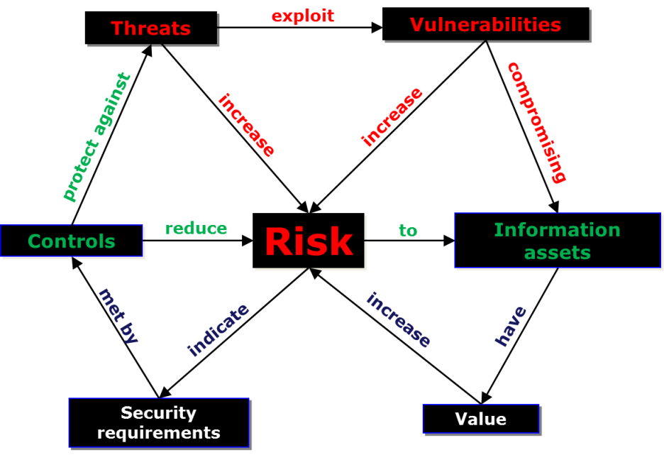
Risk Relationships

Slide 17
Threat Agent
The ‘actor’ that represents, carries out or catalyses the threat
Human
Machine
Nature

Slide 18
Threat Types
Threat type | Example
Human error | Typo, wrong attachment/email address,lost laptop or phone
Intellectual property | Piracy, industrial espionage
Deliberate act | Unauthorised access/trespass, data theft, extortion, blackmail, sabotage, vandalism, terrorist/activist/criminal activity
Fraud | Identity theft, expenses fraud
System/network attack | Viruses, worms, Trojans, hacks
Service issue | Power cuts, network outages
Force of nature | Fire, flood, storm, earthquake, lightning, tsunami, volcanic eruption
Hardware issue | Computer power supply failure,lack of capacity
Software issue | Bugs or design flaws, data corruption
Obsolescence | iPhone 4?

Slide 19
History of ISO27001
1990’s
Information Security Management Code of Practice produced by a UK government-sponsored working group
Based on the security policy used by Shell
Became British Standard BS7799
2000’s
Adopted by ISO/IEC
Became ISO/IEC 17799 (later renumbered ISO/IEC 27002)
ISO/IEC 27001 published & certification scheme started
Now
Expanding into a suite of information security standards (known as “ISO27k”)
Updated and reissued every few years

Slide 20
ISO 27001
Concerns information security management, not only IT/technical security.
Describes a management system in formal terms. Plan, Do, Check, Act (PDCA) is used to achieve, maintain, and improve security alignment with threats.
Covers all sizes and types of organizations (e.g., commercial businesses, government agencies, and non-profits).
Thousands of businesses throughout the world have been certified as compliant.

Slide 21
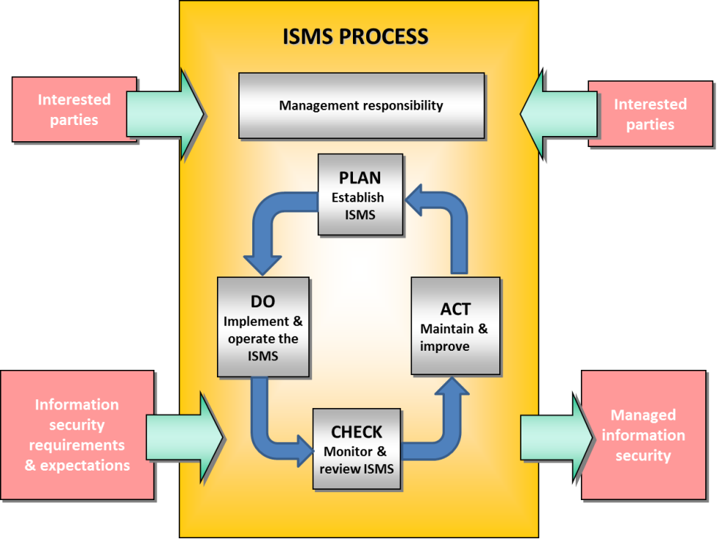
Plan Do Check Act (PDCA)

Slide 22
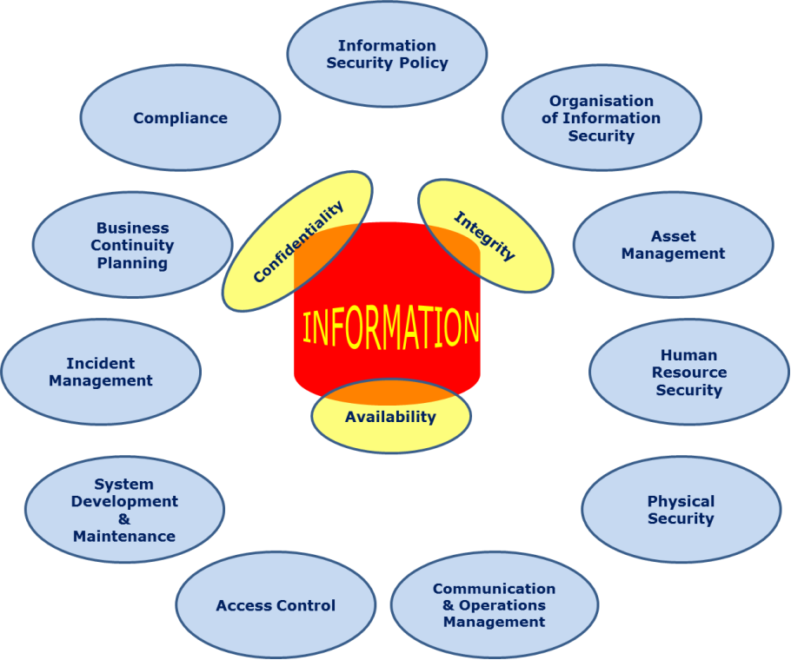
Control Clauses

Slide 23
Control Clauses
Information security policy - management direction
Organisation of information security - management framework for implementation
Asset management – assessment, classification and protection of valuable information assets
HR security – security for joiners, movers and leavers
Physical & environmental security - prevents unauthorised access, theft, compromise, damage to information and computing facilities, power cuts

Slide 24
Communications & operations management - ensures the correct and secure operation of IT
Access control – restrict unauthorised access to information assets
Information systems acquisition, development & maintenance – build security into systems
Information security incident management – deal sensibly with security incidents that arise
Business continuity management – maintain essential business processes and restore any that fail
Compliance - avoid breaching laws, regulations, policies and other security obligations

Slide 25
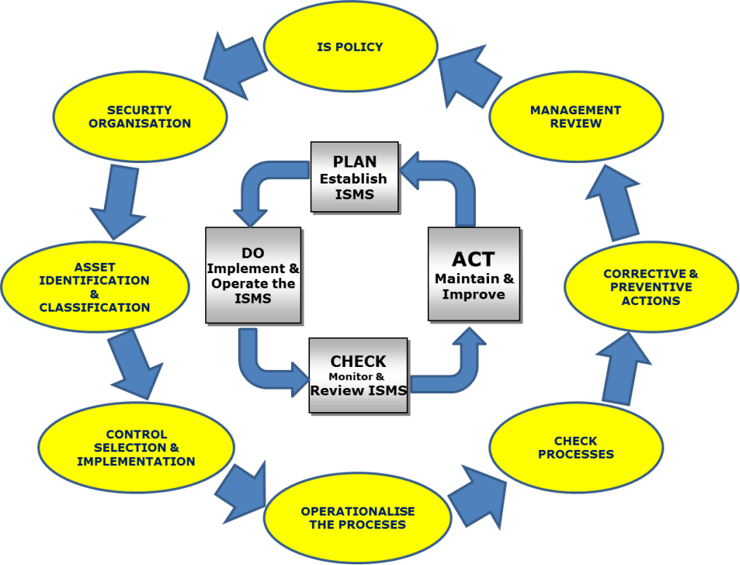
Implementation Process Cycle

Slide 26
Benefits
Demonstrable commitment to security by the organisation
Legal and regulatory compliance
Better risk management
Commercial credibility, confidence, and assurance
Reduced costs
Clear employee direction and improved awareness

Slide 27
Scope, Vision, Mission
Tellida is a Business Process Outsourcing company that provides Legal process outsourcing, finance outsourcing, call Centre outsourcing, and Tech Support. Tellida focuses on your business and helps to improve the service quality of business and it guides you to reduce the cost of your business. Tellida is a BPO firm that offers legal process outsourcing, finance outsourcing, call center outsourcing, and technical support. Tellida focuses on your business and helps you improve service quality while also guiding you to reduce costs.
Tellida operates accounting activities in Australia, the UK, and Singapore for the top 20 accounting practices. They serve as an advocate team, which has the ability to develop legislation; quotations performing AML controls; pre-contract documentation; searches before the exchange, reviews and queries; searches after exchange; and formalities for post-completion at its 24/7 call center. In 70 hospitals throughout Australia, Tellida processes more than 2000 callers every day.
Tellida is an ISO 27001:2005 certified information security organization. They protect the security and confidentiality of their client's data. Tellida has taken GDPR (General Data Protection Regulation) into regard in order to guarantee the highest level of protection for their client's personal data.

Slide 28
Key Documents
Corporate security policy at the highest level
Physical and environmental policies, email policies, HR rules, incident management policies, compliance policies, and so on.
Windows Security Standard Procedures and Guidelines, for example.
Security logs, security review reports, and remedial actions are examples of records.

Slide 29
Responsiblities
Information Security Management Committee
Information Security Manager/CISO and Department
Incident Response Team
Business Continuity Team
IT, Legal/Compliance, HR, Risk and other departments
Audit Committee

Slide 30
CONFIDENTIAL:
If this information is shared outside the company, it will result in significant financial and/or reputational damage. If this information is compromised, it could lead to major non-compliance (e.g. a privacy breach). The concept of need-to-know must be used to limit access to this information. The permission of the information owner is required for disclosure. A written confidentiality agreement is essential if information is to be provided to third parties. Customer contracts, pricing rates, trade secrets, personal information, new product development plans, budgets, financial reports (before to release), passwords, and encryption keys are all examples of confidential information.

Slide 31
INTERNAL USE ONLY
Although leaking or disclosing this information outside the business is unlikely to do substantial harm, it may result in financial loss and/or embarrassment. Circulars, rules, training materials, general company emails, security policies and procedures, and corporate intranet are just a few examples.

Slide 32
PUBLIC:
This information can be freely shared with anyone, albeit it is normally only done with the permission of Corporate Communications or Marketing. Marketing brochures, press releases, and websites are just a few examples.

Slide 33
Confidentiality level | Explanation
High | Information that is very sensitive or private, has a high value to the organization, and is only intended for a small number of people. Unauthorized revelation of such information can result in serious consequences, including legal or financial penalties, competitive disadvantage, and brand value loss (for example, merger and acquisition-related information, marketing plan).
Medium | Information that belongs to the company and should not be shared with the public or outside parties. Unauthorized exposure of this information, such as organizational charts and internal contact lists, may cause some harm to the organization.
Low | Information that is not sensitive is eligible for public dissemination. Unauthorized exposure of such information will have no negative impact on the organization. E.g. Press releases, e.g., company newsletters On the company's website, information is available.

Slide 34
Physical Security
DO
Security policies and procedures should be read and followed.
While on the grounds, show your identification cards.
Anyone without an ID card should be challenged or reported.
For help with most information security issues, go to the intranet Security Zone or call the IT Help/Service Desk.

Slide 35
Physical Security
DO NOT
Allow uninvited guests to enter the property
Weapons, hazardous/combustible materials, recording devices, and other items should be brought, especially in secure places.
Unless specifically authorized by management, use personal IT devices for work.

Slide 36
Password Guidelines
DO
Use long, complicated passwords - whole sentences if you can
Reserve your strongest passwords for high security systems (don’t re-use the same passphrase everywhere)
Use famous quotes, lines from your favorite songs, poems etc. to make them memorable

Slide 37
Password Guidelines
DO NOT
Use short or easily-guessed passwords
Write down passwords or store them in plain text
Share passwords over phone or email

Slide 38
Internet Usage
DO
Use the corporate Internet facilities only for legitimate and authorized business purposes
DO NOT
Avoid websites that would be classed as obscene, racist, offensive or illegal – anything that would be embarrassing
Do not access online auction or shopping sites, except where authorised by your manager
Don’t hack!
Do not download or upload commercial software or other copyrighted material without the correct license and permission from your manager

Slide 39
E-mail Usage
DO
Use corporate email for business purposes only
Follow the email storage guidelines
If you receive spam email, simply delete it. If it is offensive or you receive a lot, call the IT Help/Service Desk
DO NOT
Do not use your corporate email address for personal email
Do not circulate chain letters, hoaxes, inappropriate jokes, videos etc.
Do not send emails outside the organization unless you are authorized to do so
Be very wary of email attachments and links, especially in unsolicited emails (most are virus-infected)

Slide 40
Security Incidents
DO
Report information security incidents, concerns and near-misses to IT Help/Service Desk:
Email …
Telephone …
Anonymous drop-boxes …
Take their advice on what to do
DO NOT
Do not discuss security incidents with anyone outside the organisation
Do not attempt to interfere with, obstruct or prevent anyone else from reporting incidents

Slide 41
User Responsibilities
Check for antivirus updates and fixes on your computer.
Before leaving your PC unattended, lock your keyboard (Windows L) and log off at the end of the day.
Securely store laptops and valuable information (paperwork, CDs, USB sticks, and so on) under lock and key. While traveling, have your wits about you:
On the phone,
keep your voice low.
Keep your computer equipment hidden.
Back up your data on a regular basis. Meet your security responsibilities:
Security and privacy rules, copyright and licensing, NDAs (Non Disclosure Agreements), and contracts must all be followed.
Follow the company's policies and procedures.
Keep up with the latest in information security:
Review the Flomatik website's information security policies under the staff area.

Slide 42
Thank You!

